Slide 1





Web Scraping & Web Services

Slide 2

Hello!
I am Eslam Ahmed
I am a software engineer.
You can find me at jeksogsa@gmail.com

Slide 3
Agenda
What is Network Topologies
What is Internet and Web Servers
HTTP Request/Response Cycle
HTML
CSS
Scrapping Concept
BeautifulSoap Library
REST API Web Services
Work with JSON

Slide 4
Agenda
What is Network Topologies
What is Internet and Web Servers
HTTP Request/Response Cycle
HTML
CSS
Scrapping Concept
BeautifulSoap Library
REST API Web Services
Work with JSON

Slide 5
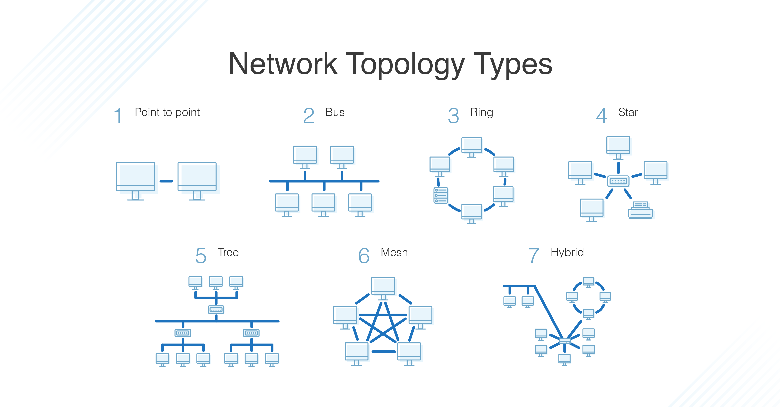



What is Network Topologies

Slide 6
Agenda
What is Network Topologies
What is Internet and Web Servers
HTTP Request/Response Cycle
HTML
CSS
Scrapping Concept
BeautifulSoap Library
REST API Web Services
Work with JSON

Slide 7
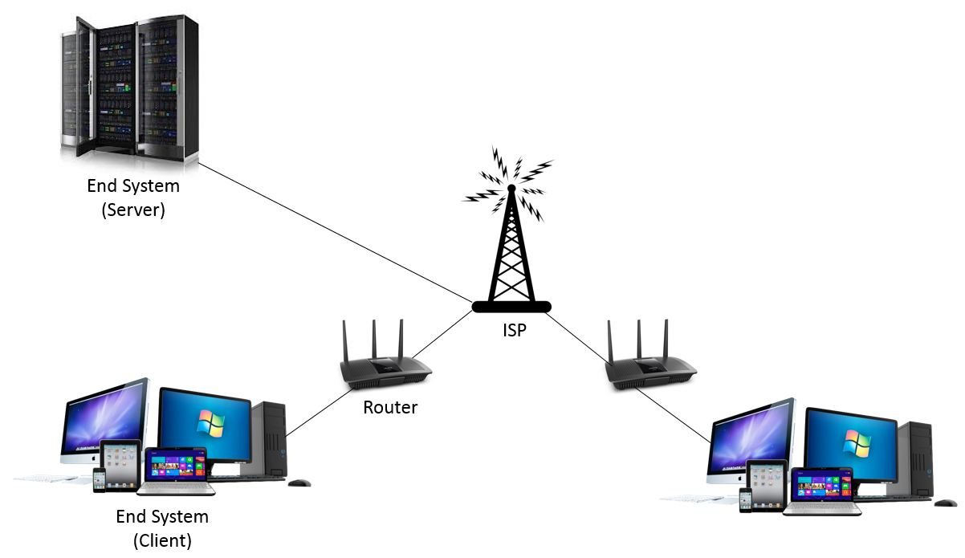
What is Internet and Web Servers

Slide 8
Agenda
What is Network Topologies
What is Internet and Web Servers
HTTP Request/Response Cycle
HTML
CSS
Scrapping Concept
BeautifulSoap Library
REST API Web Services
Work with JSON

Slide 9
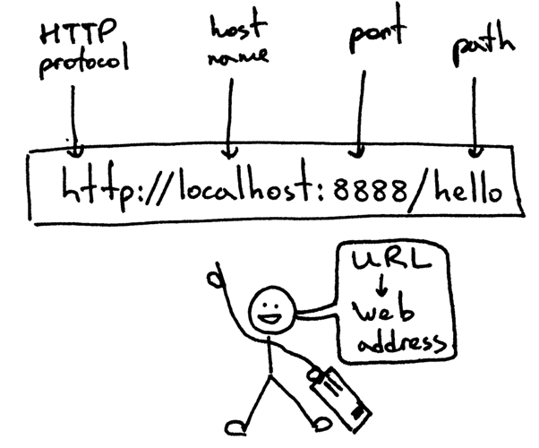
HTTP Request/Response Cycle

Slide 10
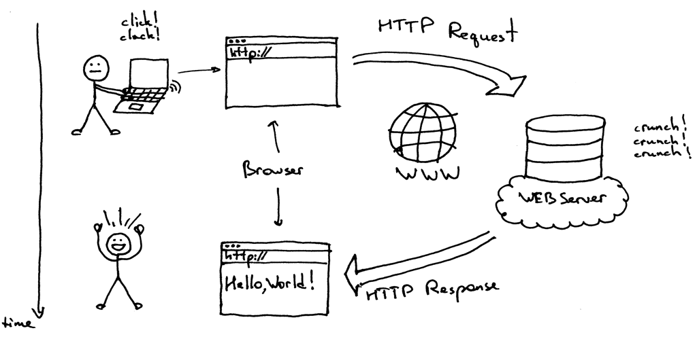
HTTP Request/Response Cycle

Slide 11
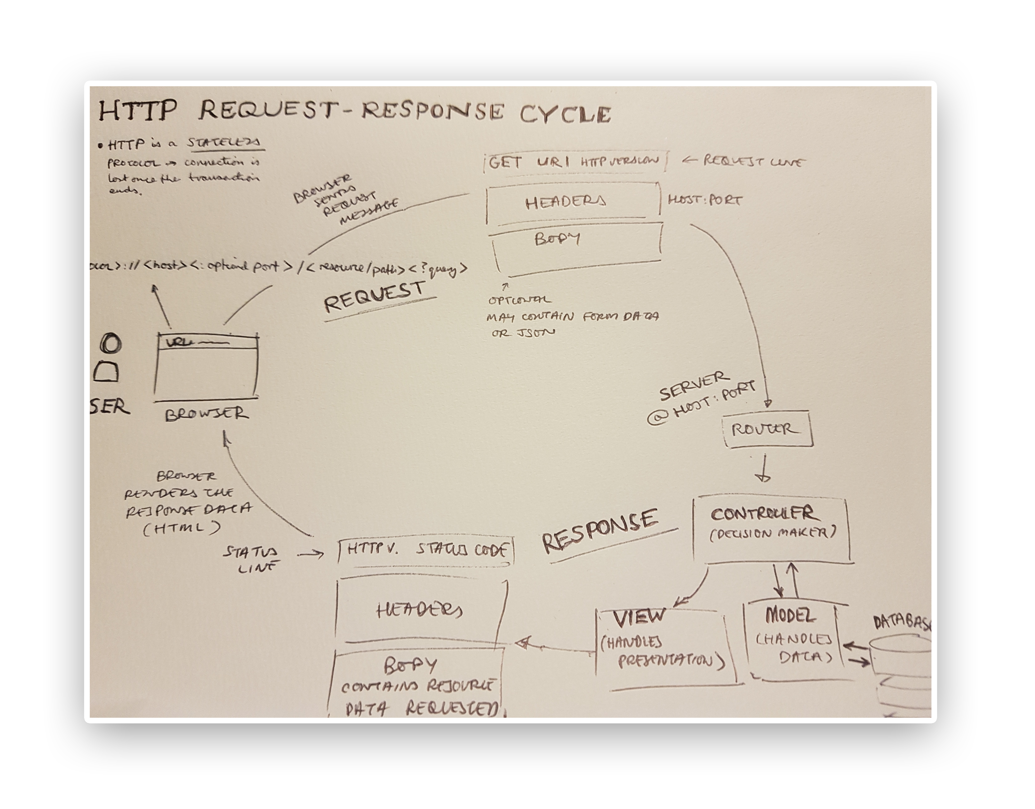

Slide 12
Agenda
What is Network Topologies
What is Internet and Web Servers
HTTP Request/Response Cycle
HTML
CSS
Scrapping Concept
BeautifulSoap Library
REST API Web Services
Work with JSON

Slide 13
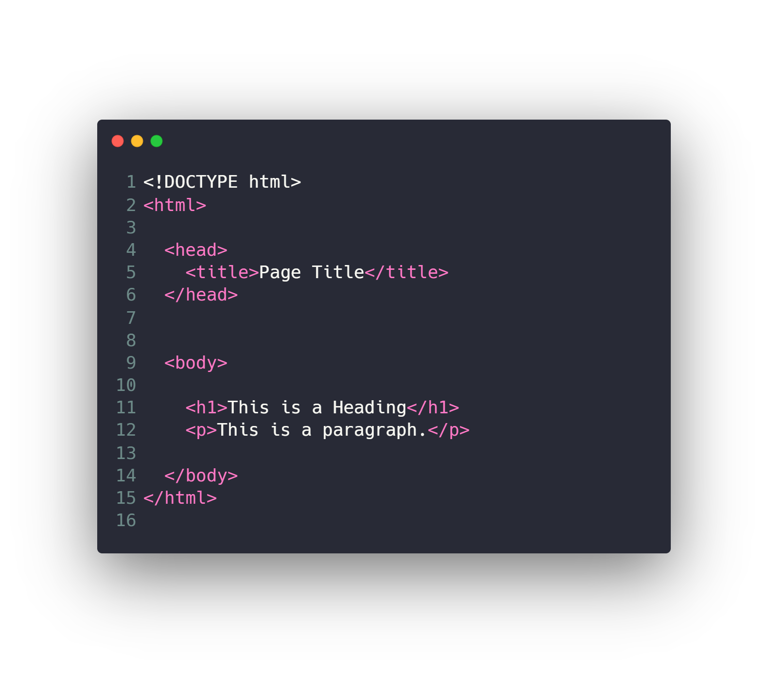
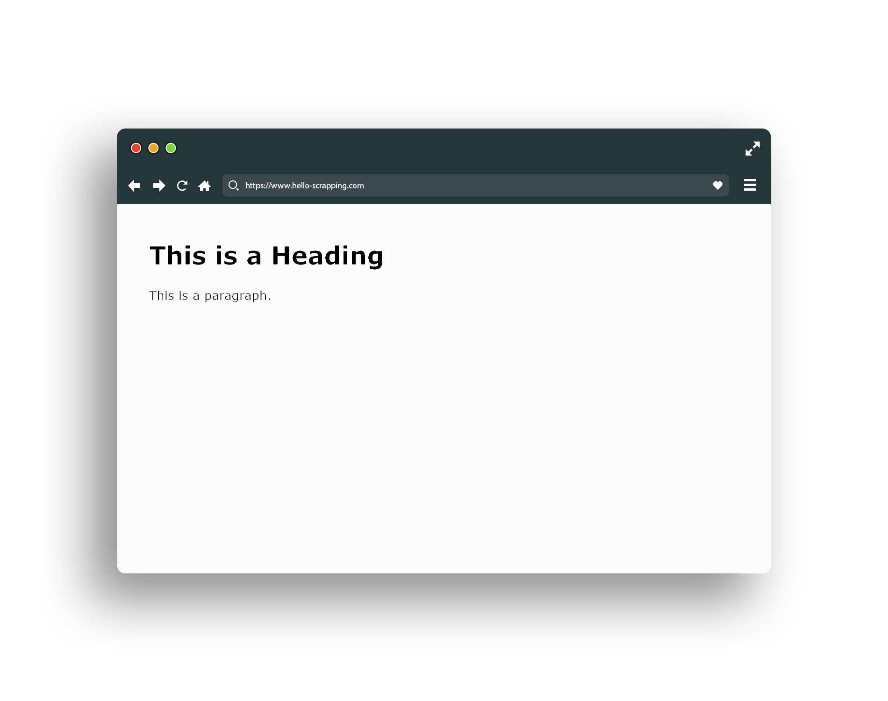
HTML (base snippet code)

Slide 14
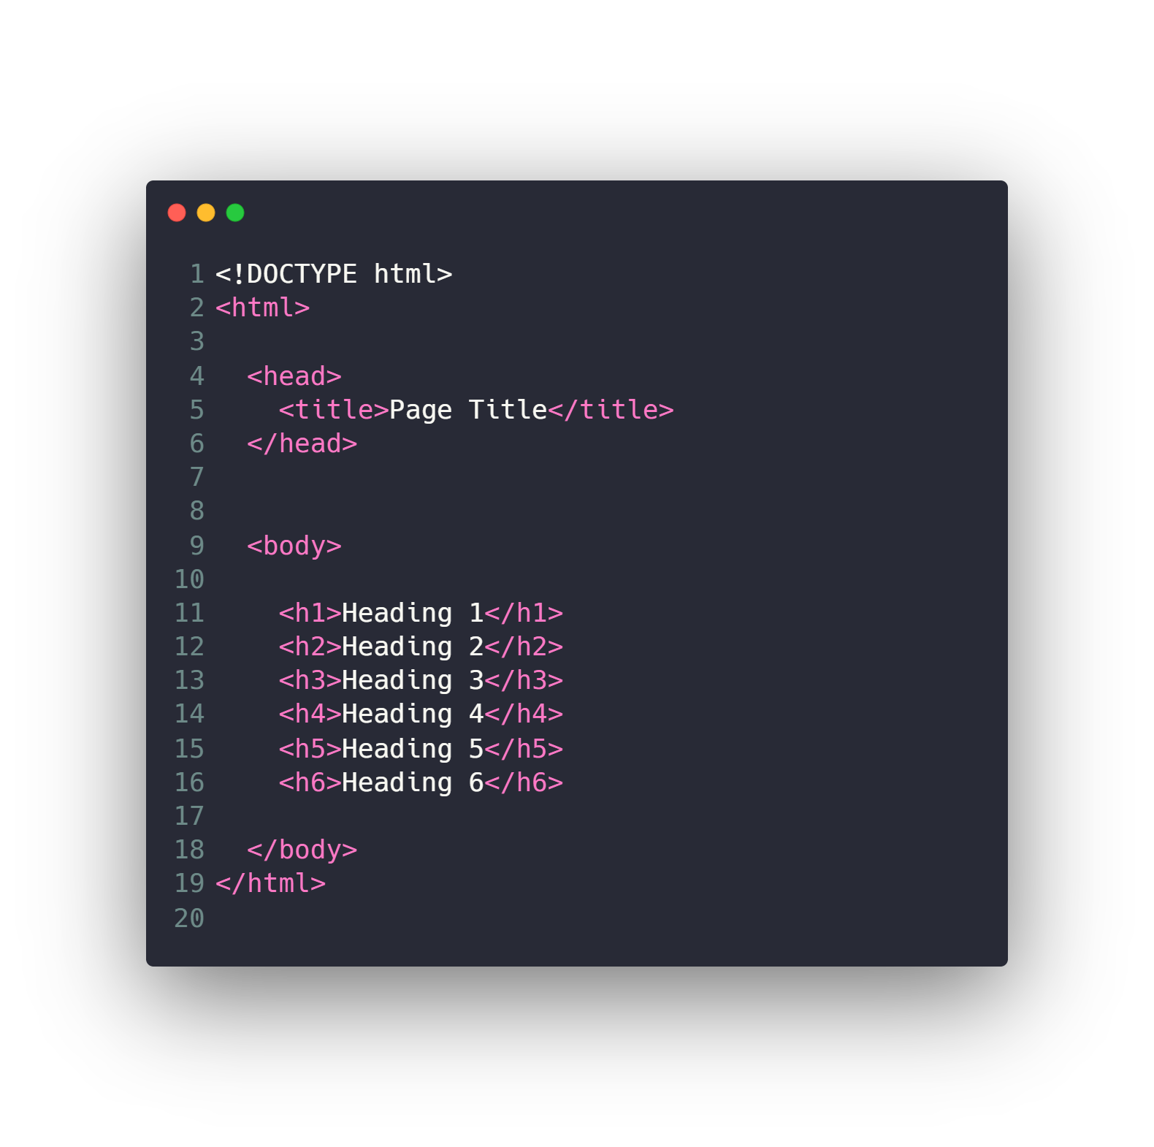
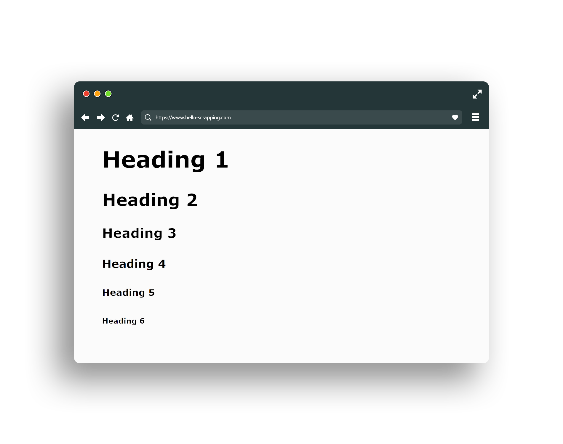
HTML (header)

Slide 15
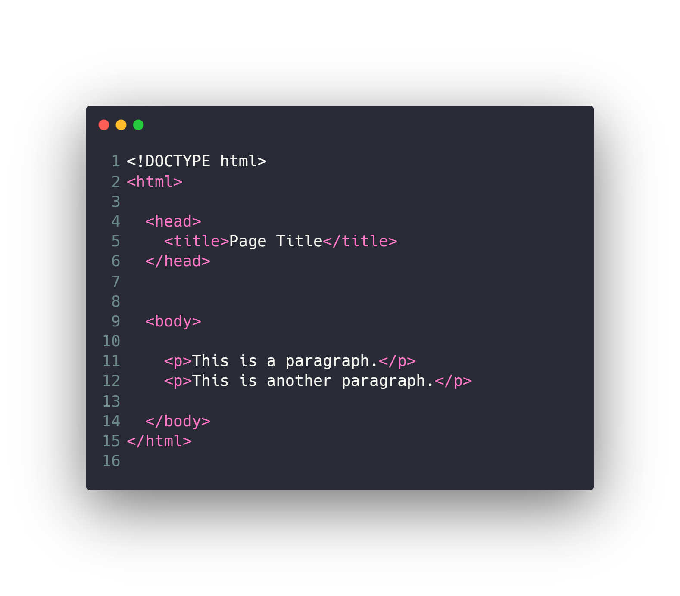
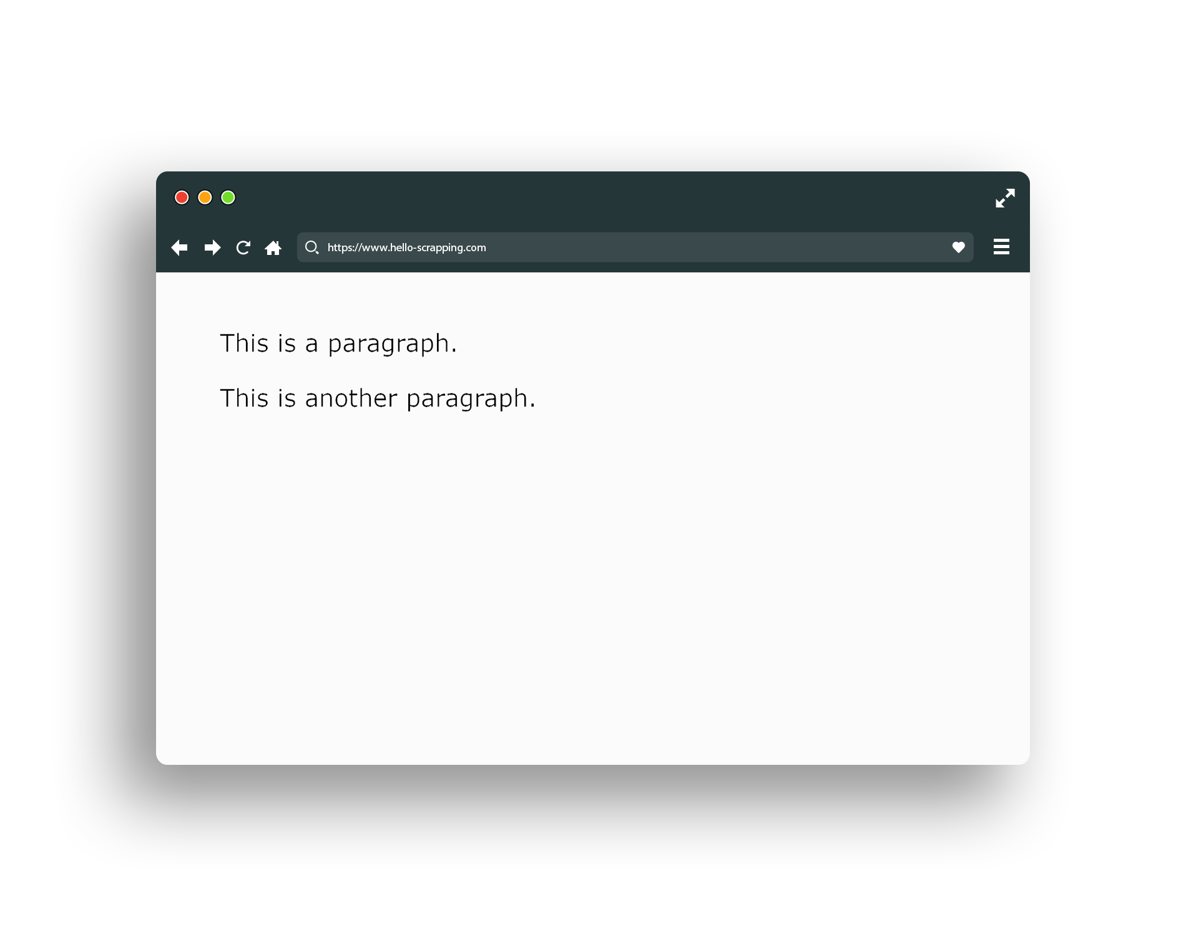
HTML (paragraph)

Slide 16
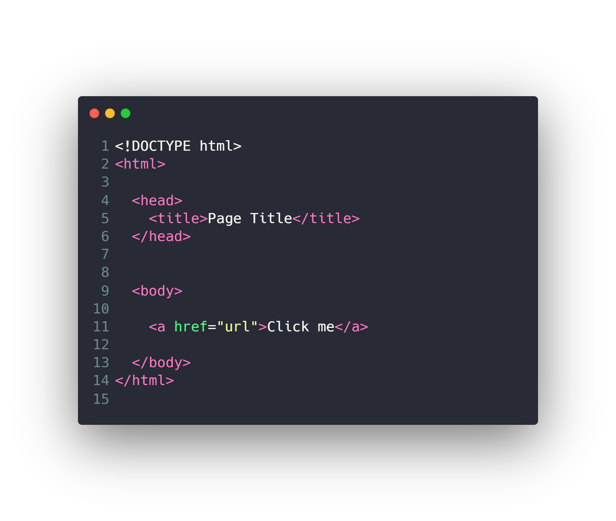
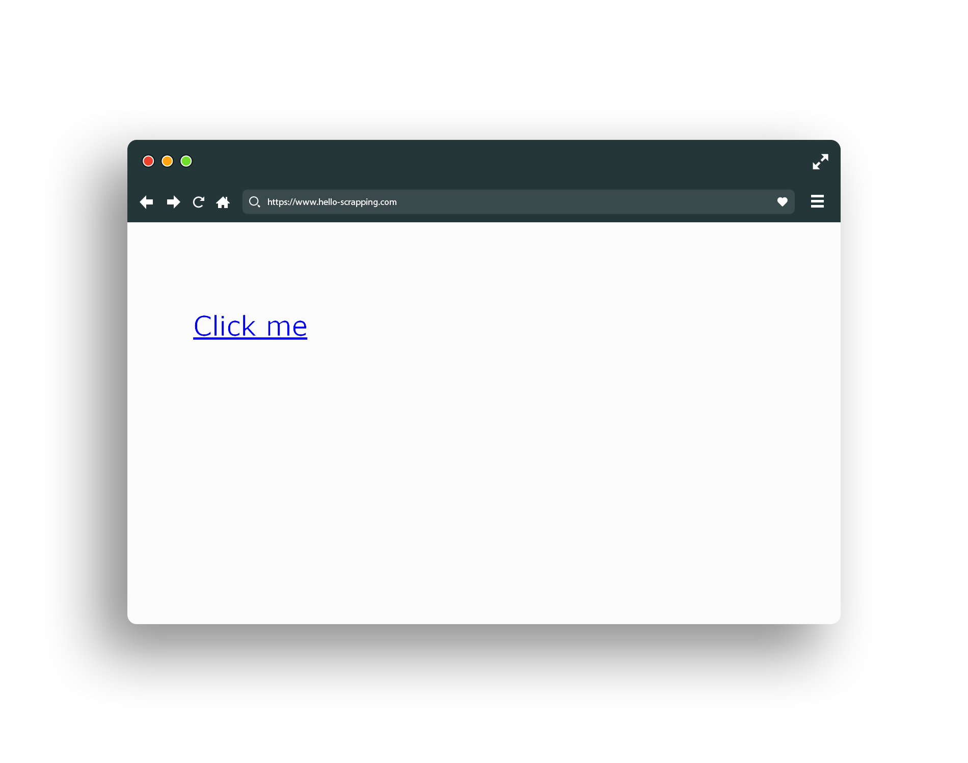
HTML (link)

Slide 17
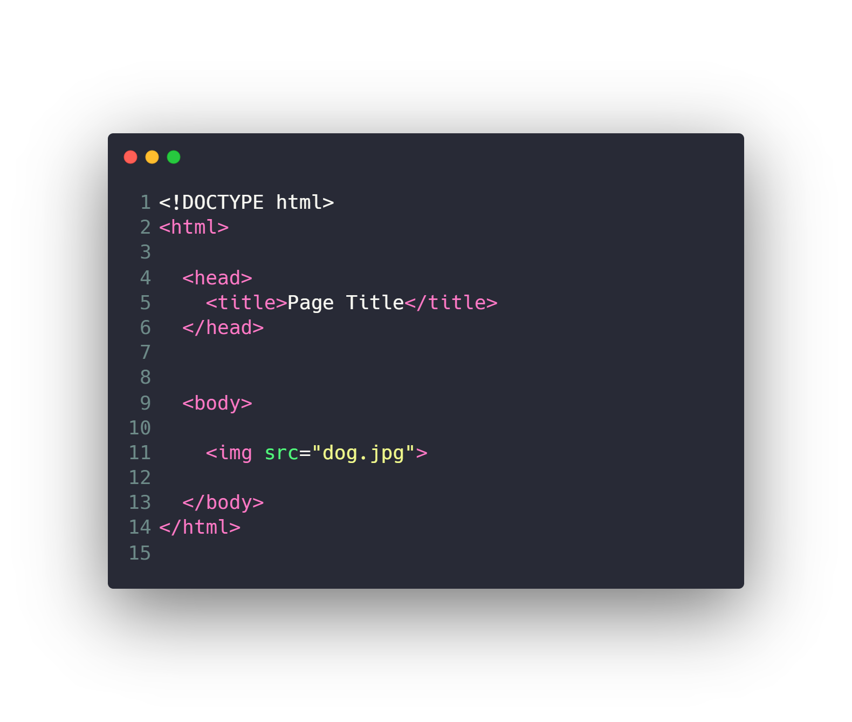
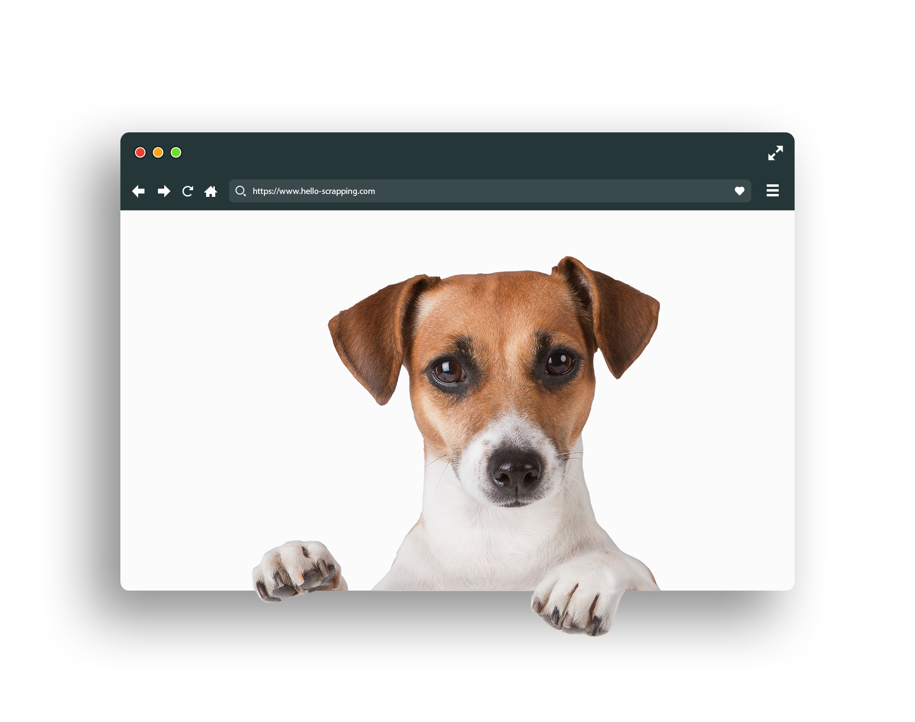
HTML (image)

Slide 18
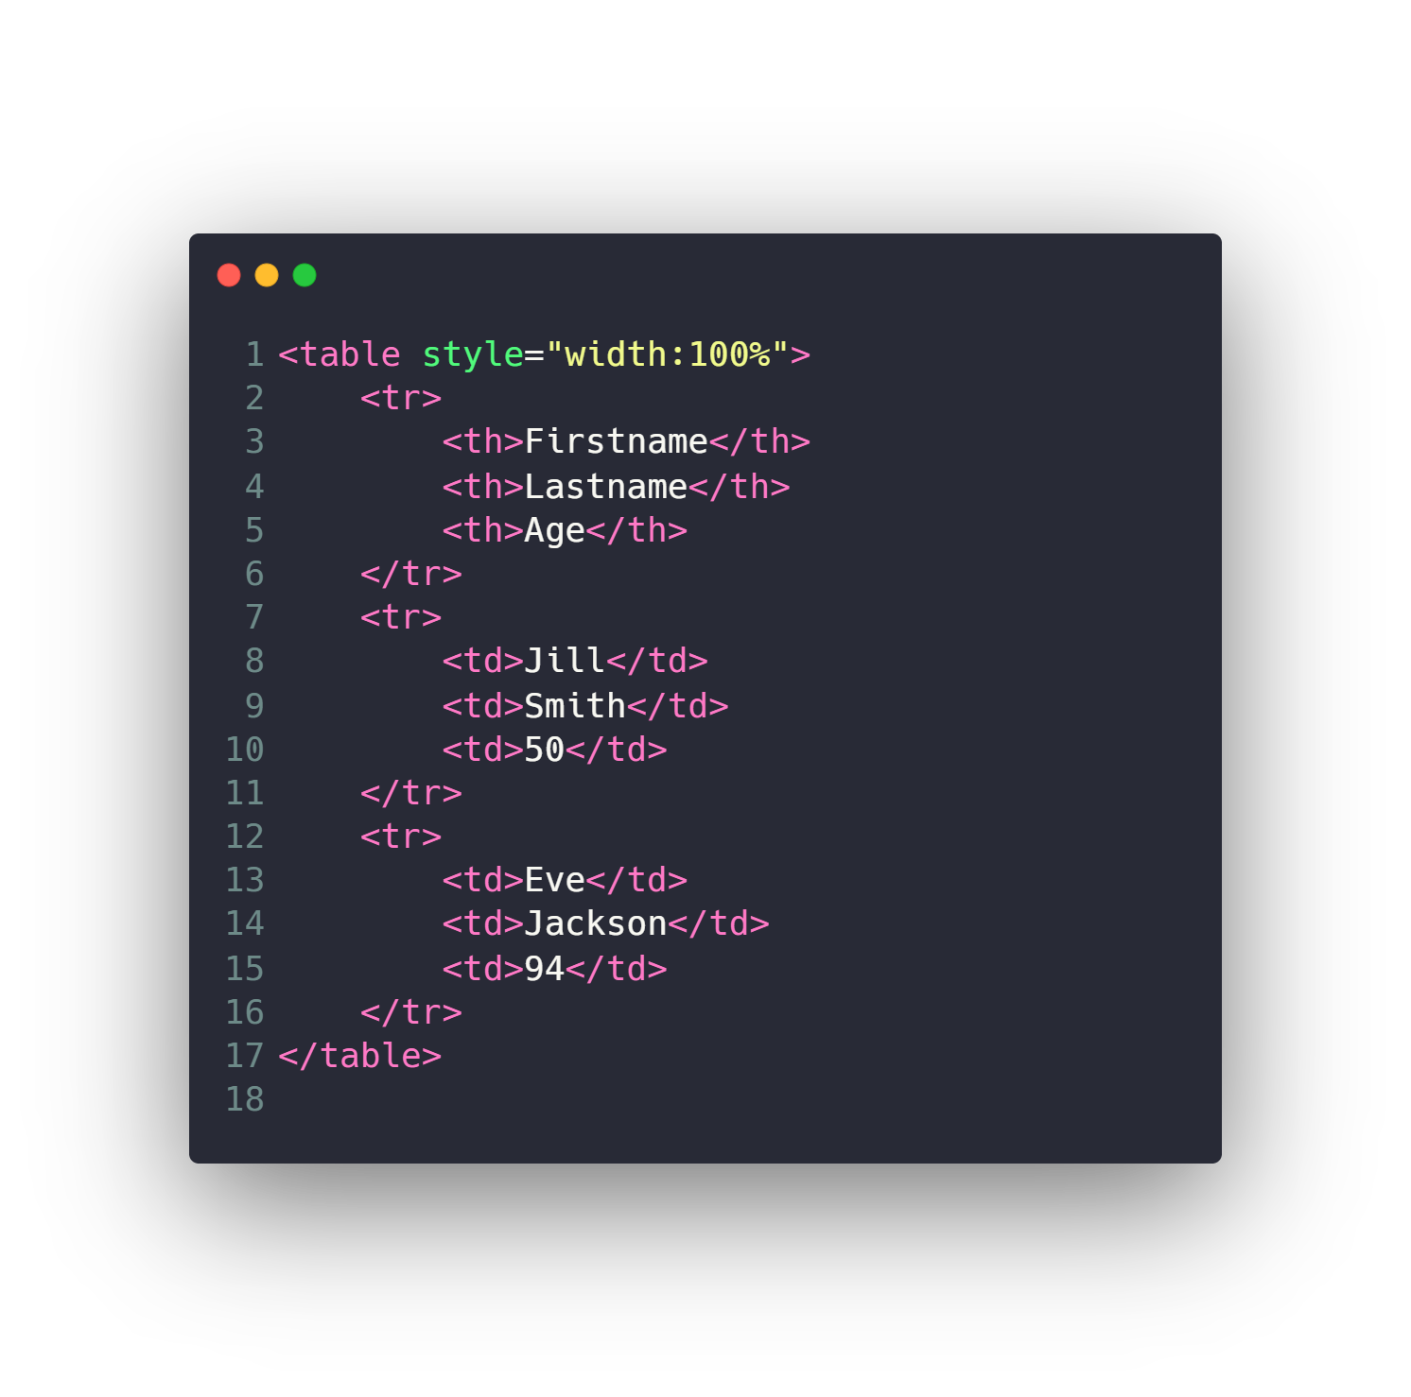
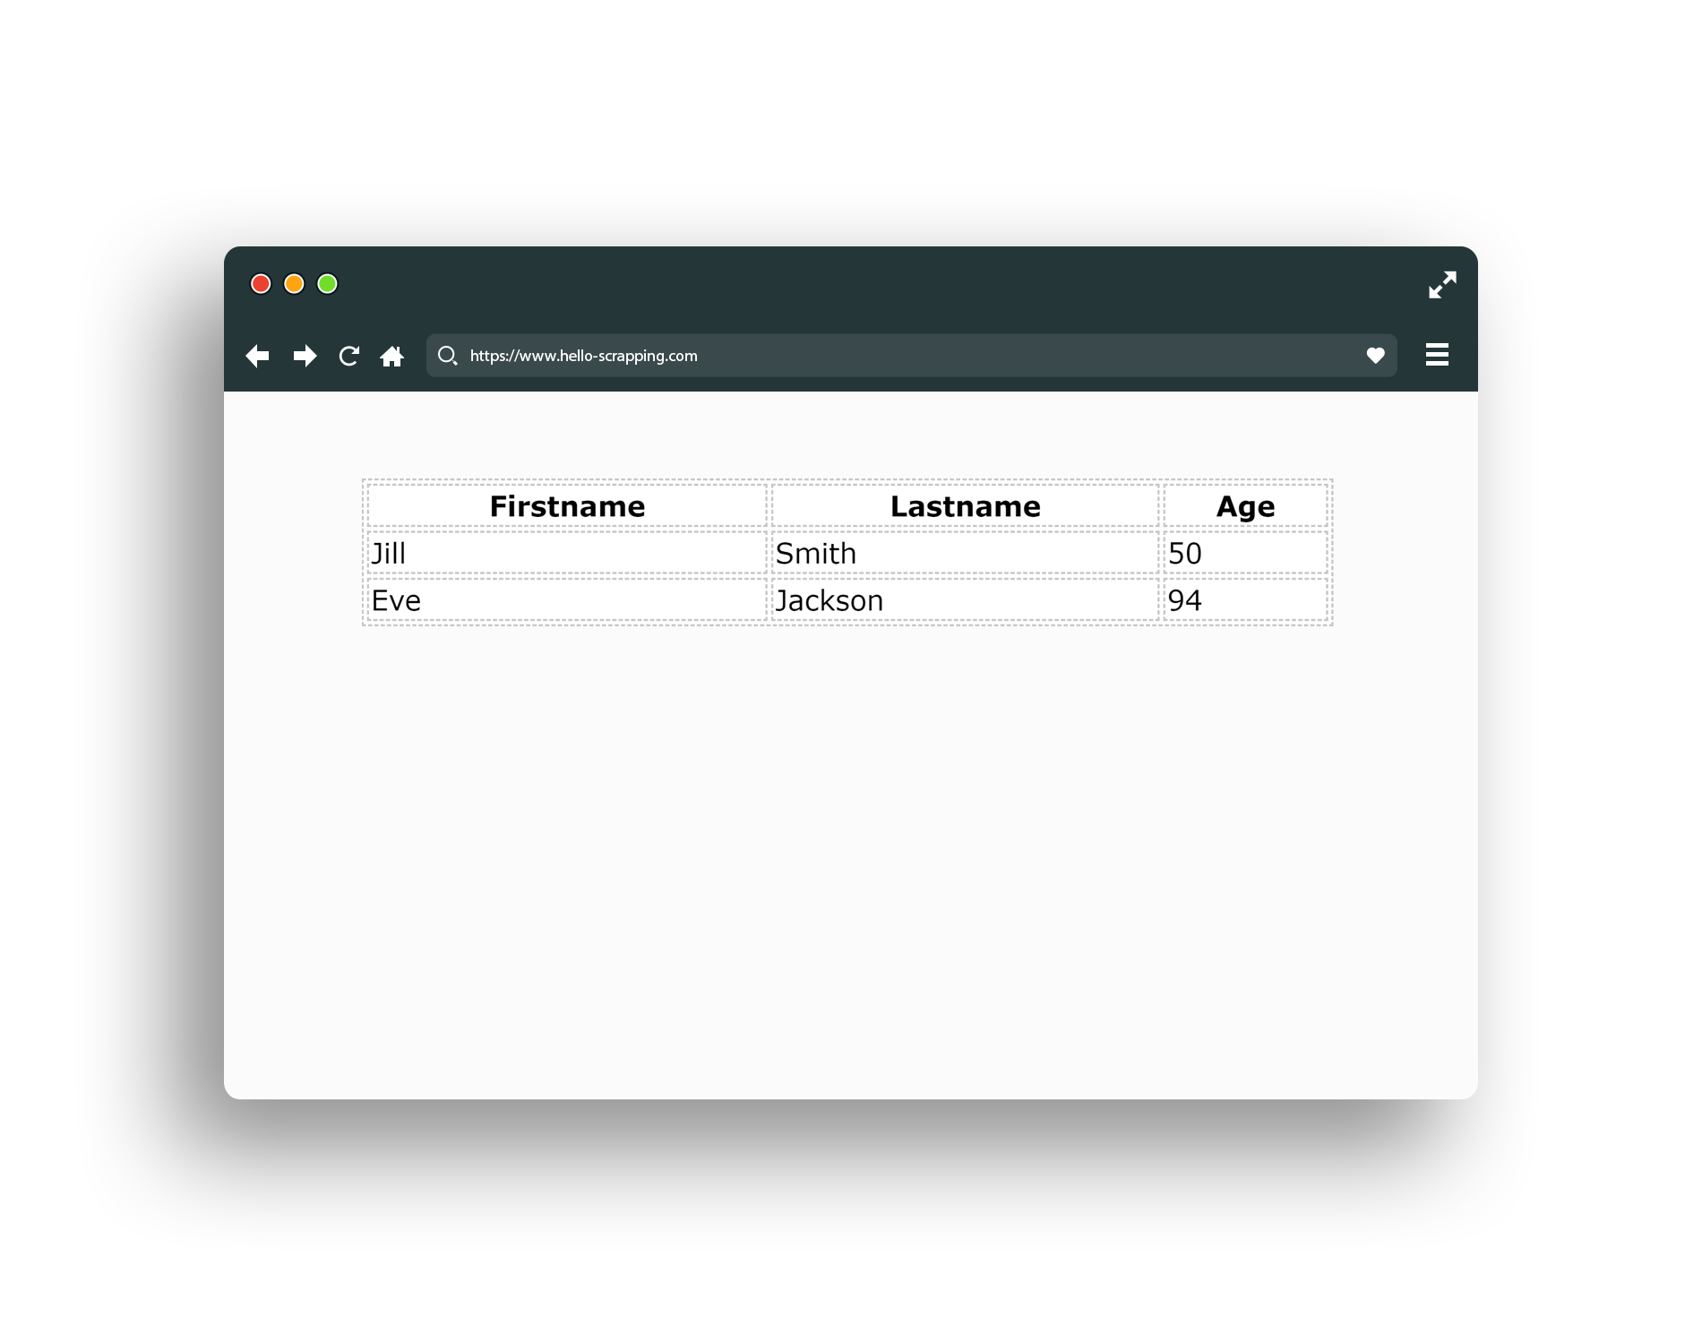
HTML (table)

Slide 19
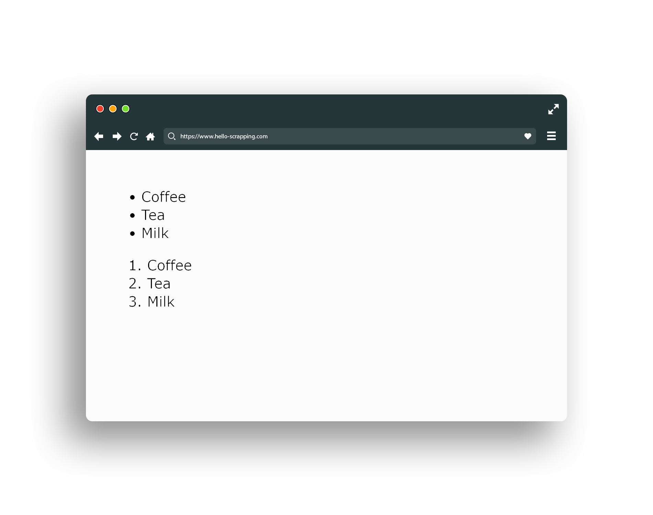
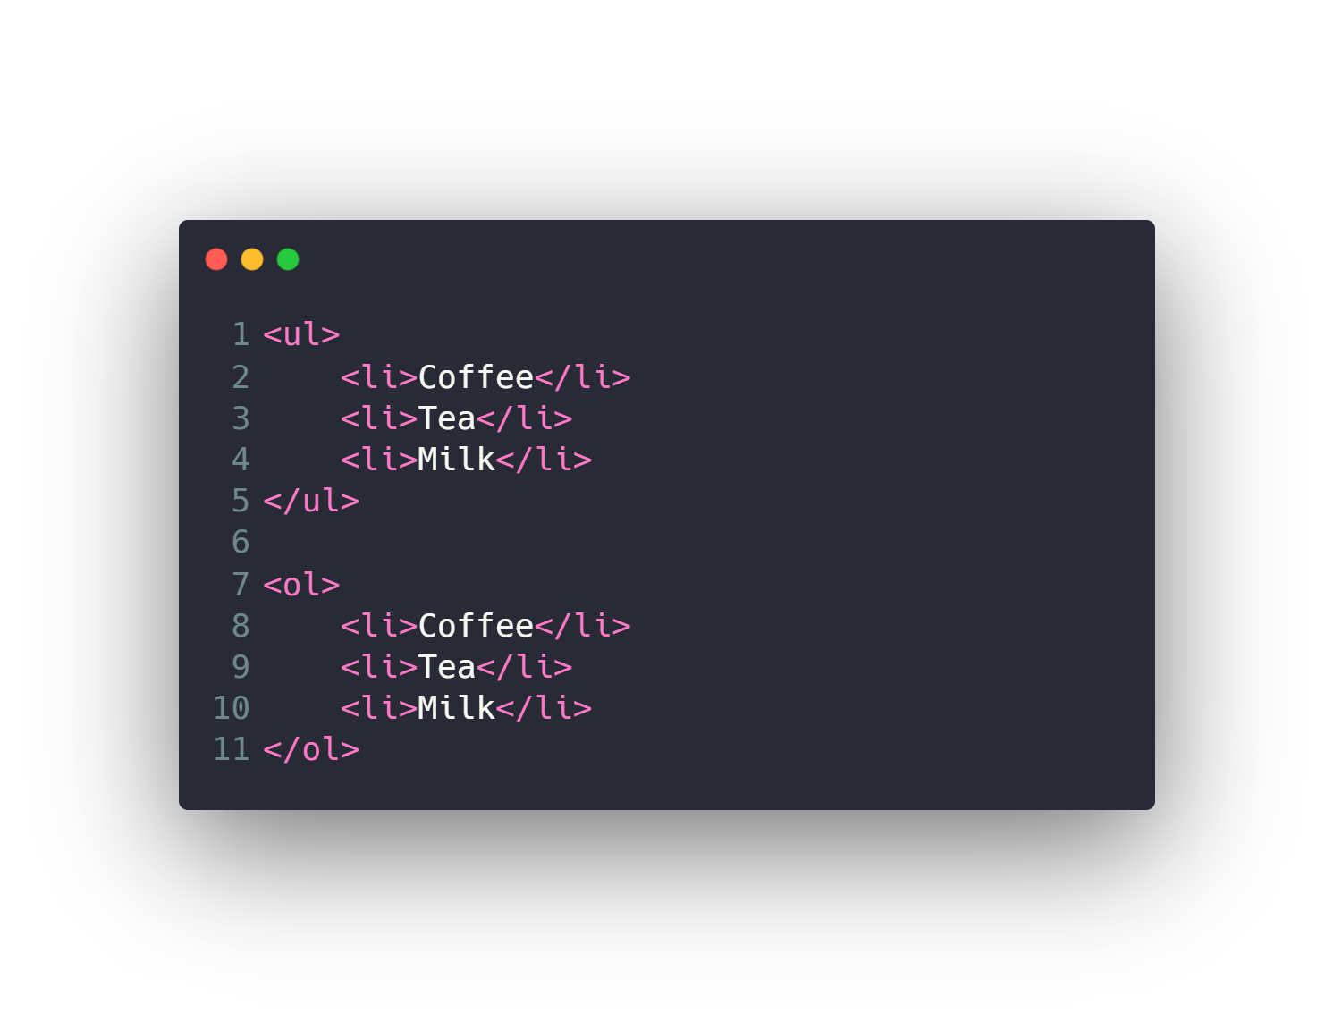
HTML (list)

Slide 20
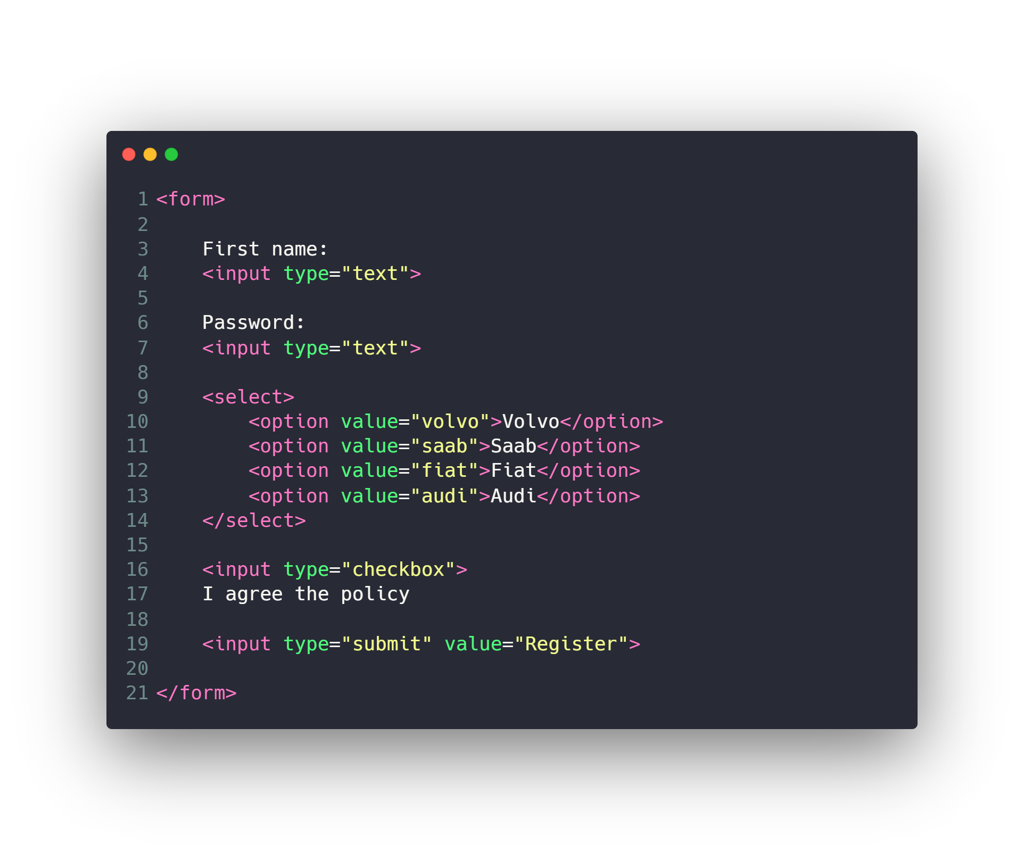
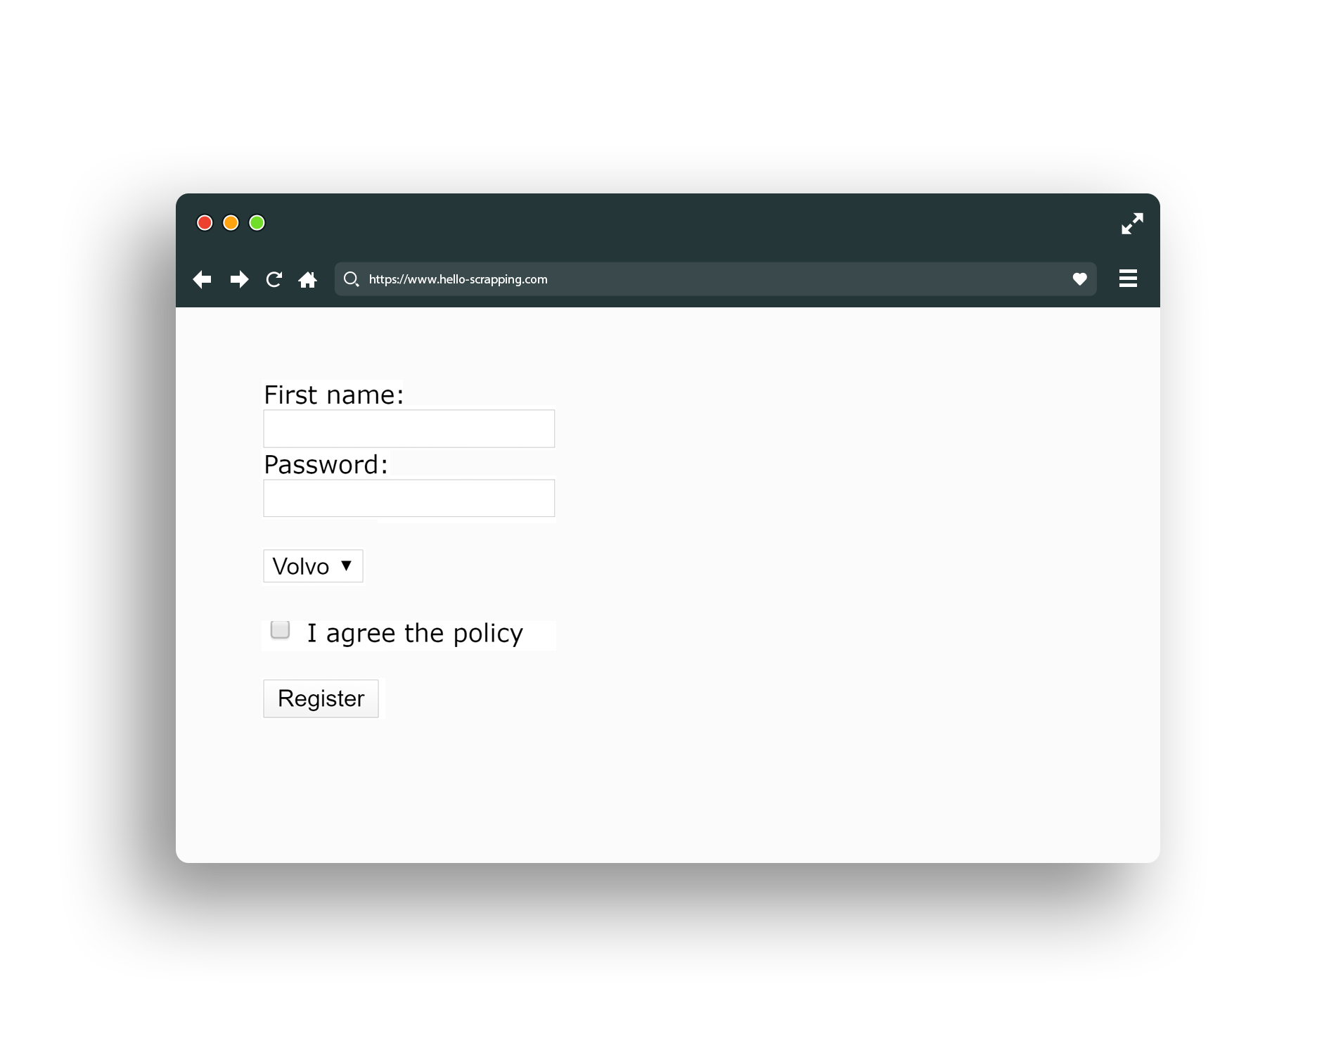
HTML (form)

Slide 21
Other HTML Elements
Div
Span
Video
Audio
Iframe
Header
Footer
Canvas
…

Slide 22
Agenda
What is Network Topologies
What is Internet and Web Servers
HTTP Request/Response Cycle
HTML
CSS
Scrapping Concept
BeautifulSoap Library
REST API Web Services
Work with JSON

Slide 23
CSS
Text & Fonts
Colors
Backgrounds
Borders
Margin & Padding
Width & Height
Gradient
Shadows
…

Slide 24
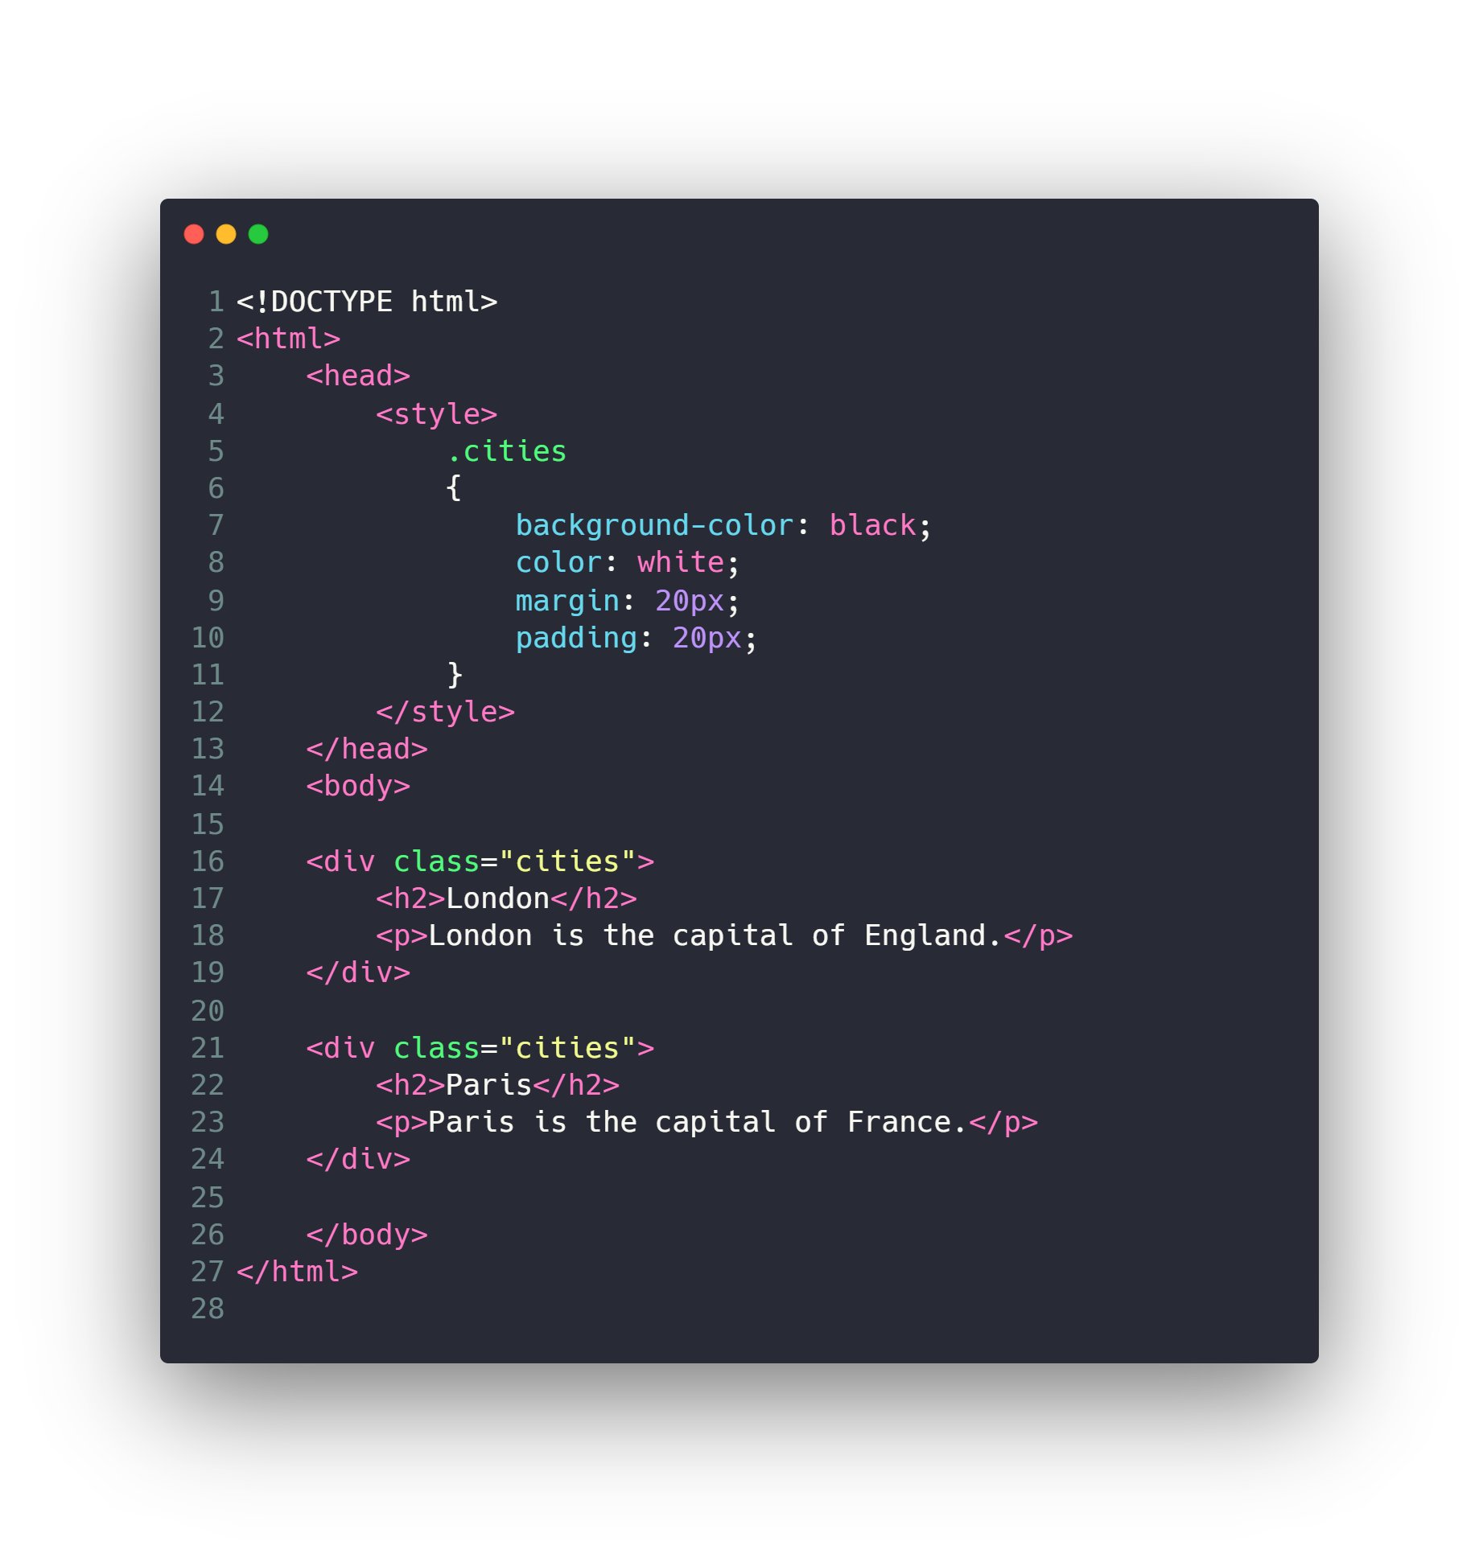
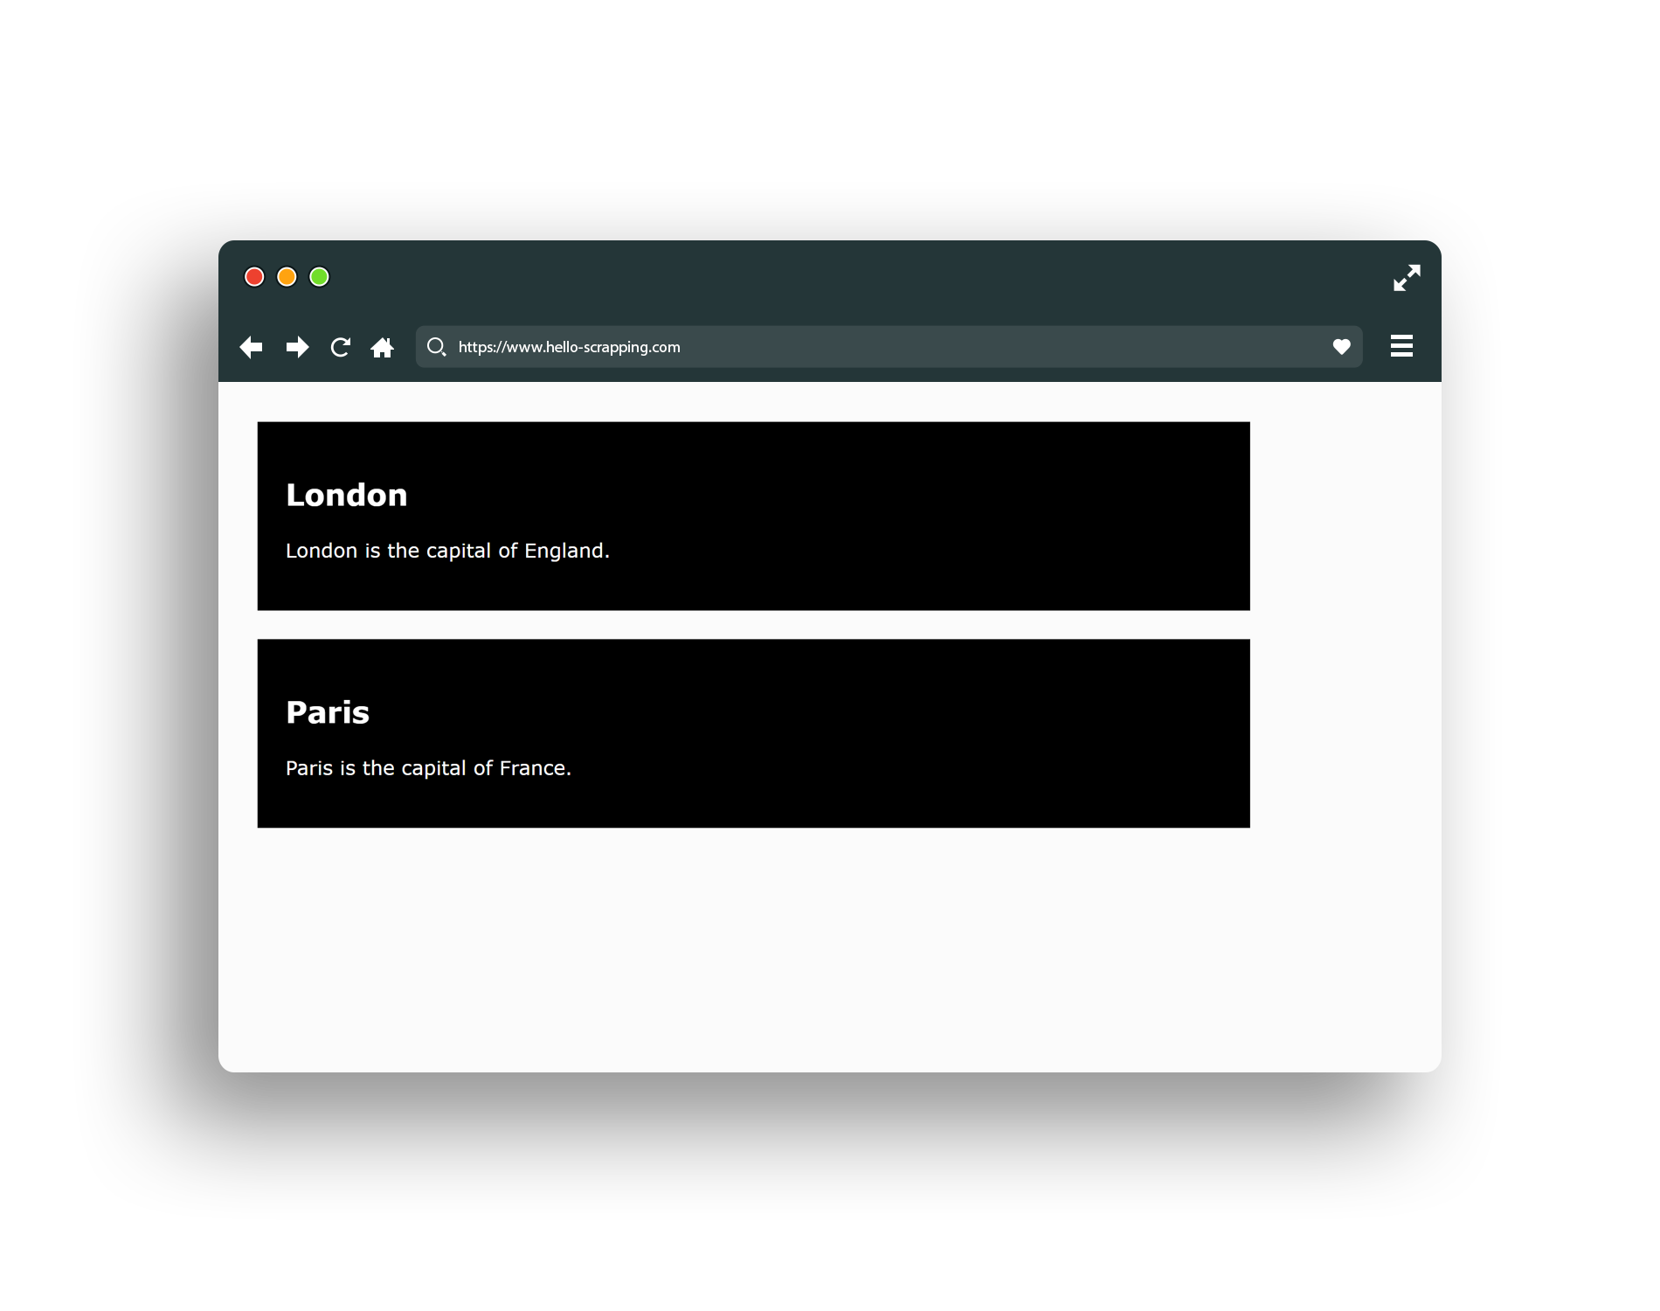
Classes and ID

Slide 25

Check Also
JavaScript
React & Angular
Ajax
Web Sockets
…

Slide 26
Agenda
What is Network Topologies
What is Internet and Web Servers
HTTP Request/Response Cycle
HTML
CSS
Scrapping Concept
BeautifulSoap Library
REST API Web Services
Work with JSON

Slide 27

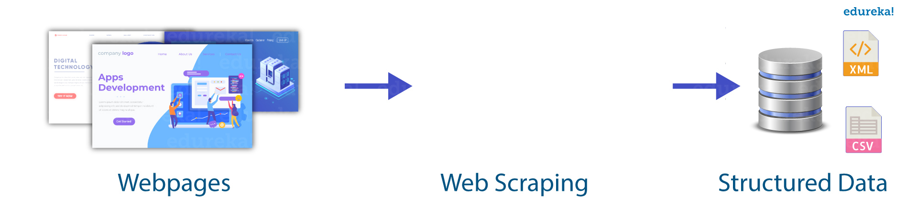
Scrapping Concept

Slide 28
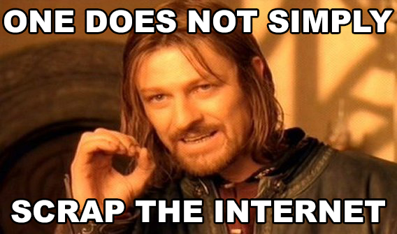
Scrapping Concept

Slide 29
Agenda
What is Network Topologies
What is Internet and Web Servers
HTTP Request/Response Cycle
HTML
CSS
Scrapping Concept
BeautifulSoap Library
REST API Web Services
Work with JSON

Slide 30
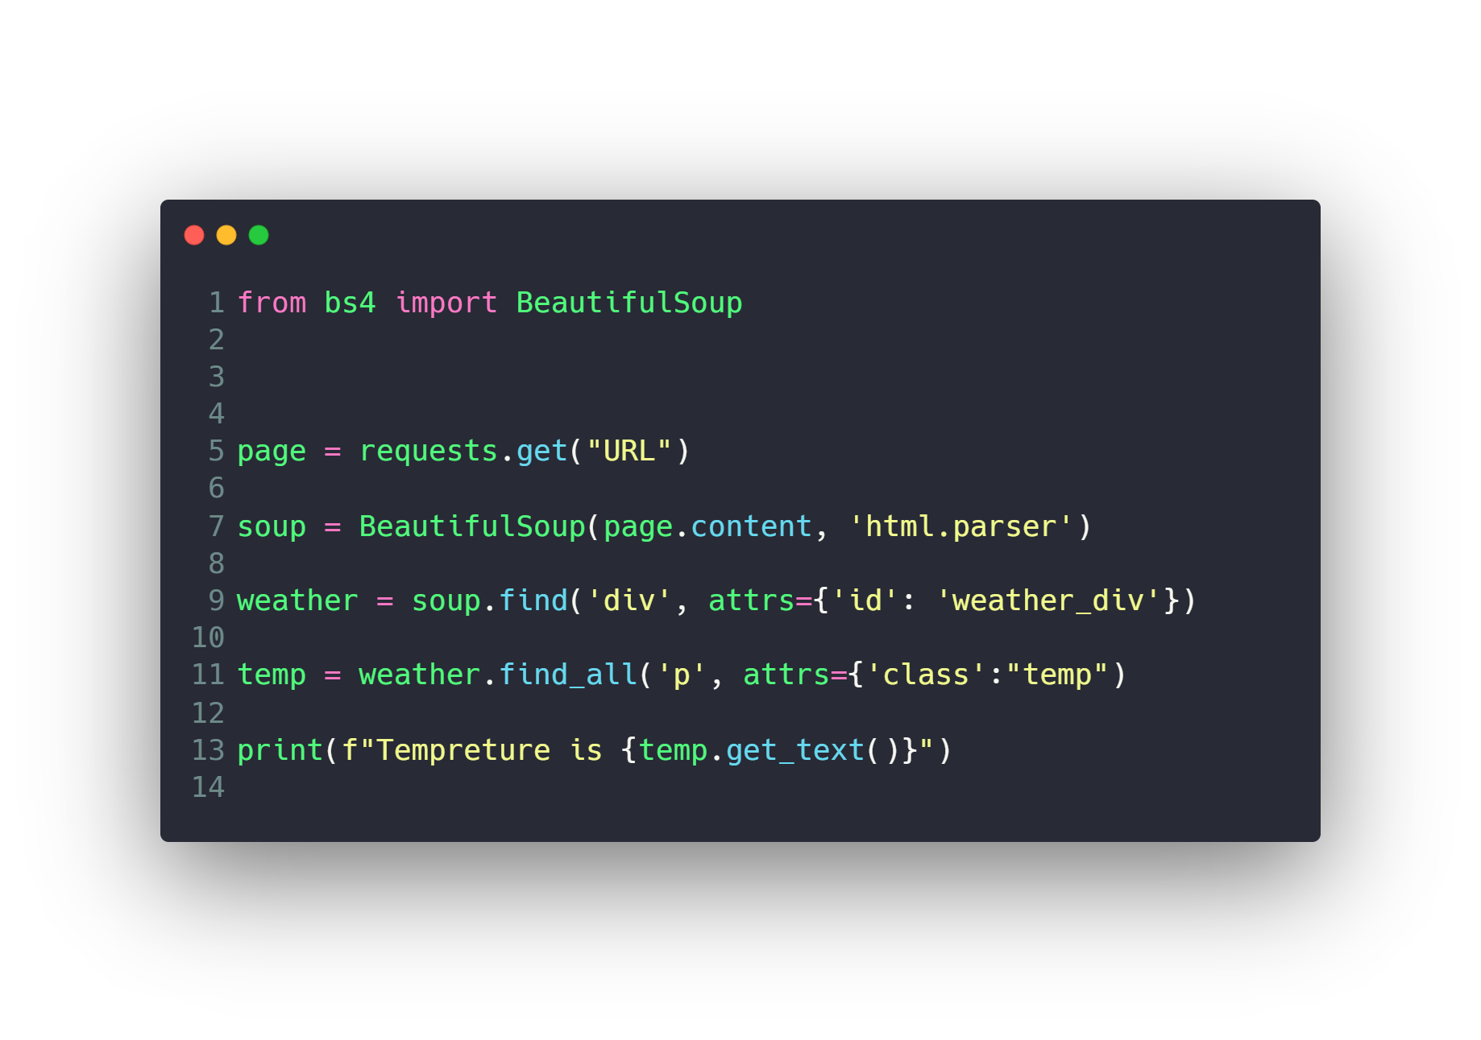
BeautifulSoap Library

Slide 31
Agenda
What is Network Topologies
What is Internet and Web Servers
HTTP Request/Response Cycle
HTML
CSS
Scrapping Concept
BeautifulSoap Library
REST API Web Services
Work with JSON

Slide 32
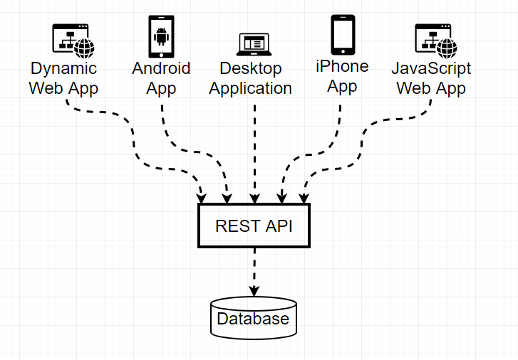
REST API Web Services

Slide 33
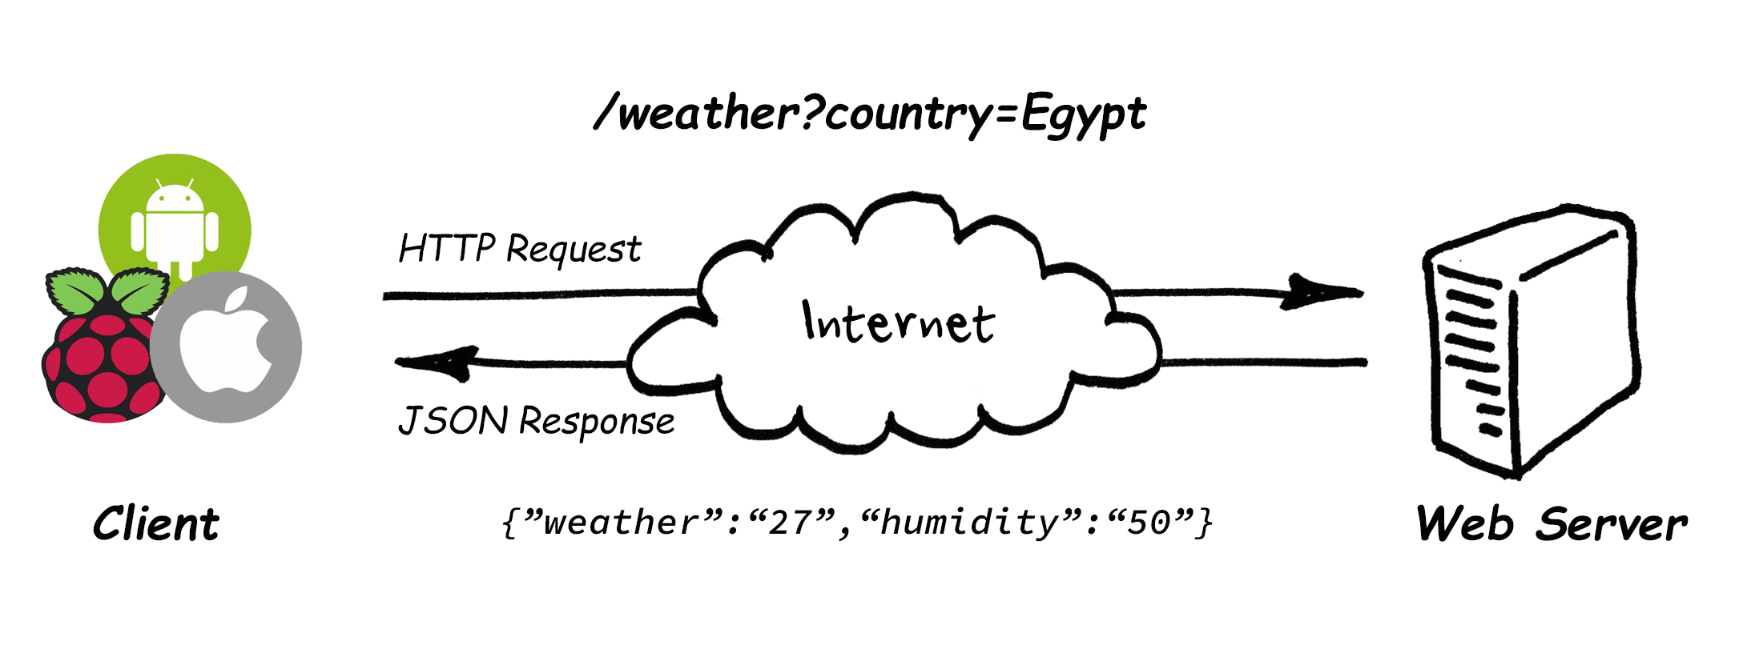
REST API Web Services

Slide 34
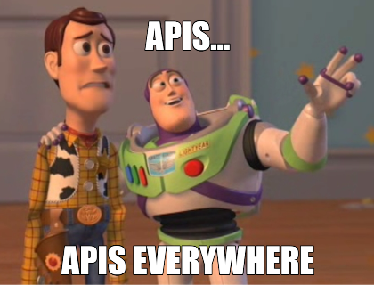
REST API Web Services
https://any-api.com/
https://github.com/public-apis/public-apis
https://cloud.google.com/products/ai
https://www.twilio.com/
....

Slide 35
Agenda
What is Network Topologies
What is Internet and Web Servers
HTTP Request/Response Cycle
HTML
CSS
Scrapping Concept
BeautifulSoap Library
REST API Web Services
Work with JSON

Slide 36
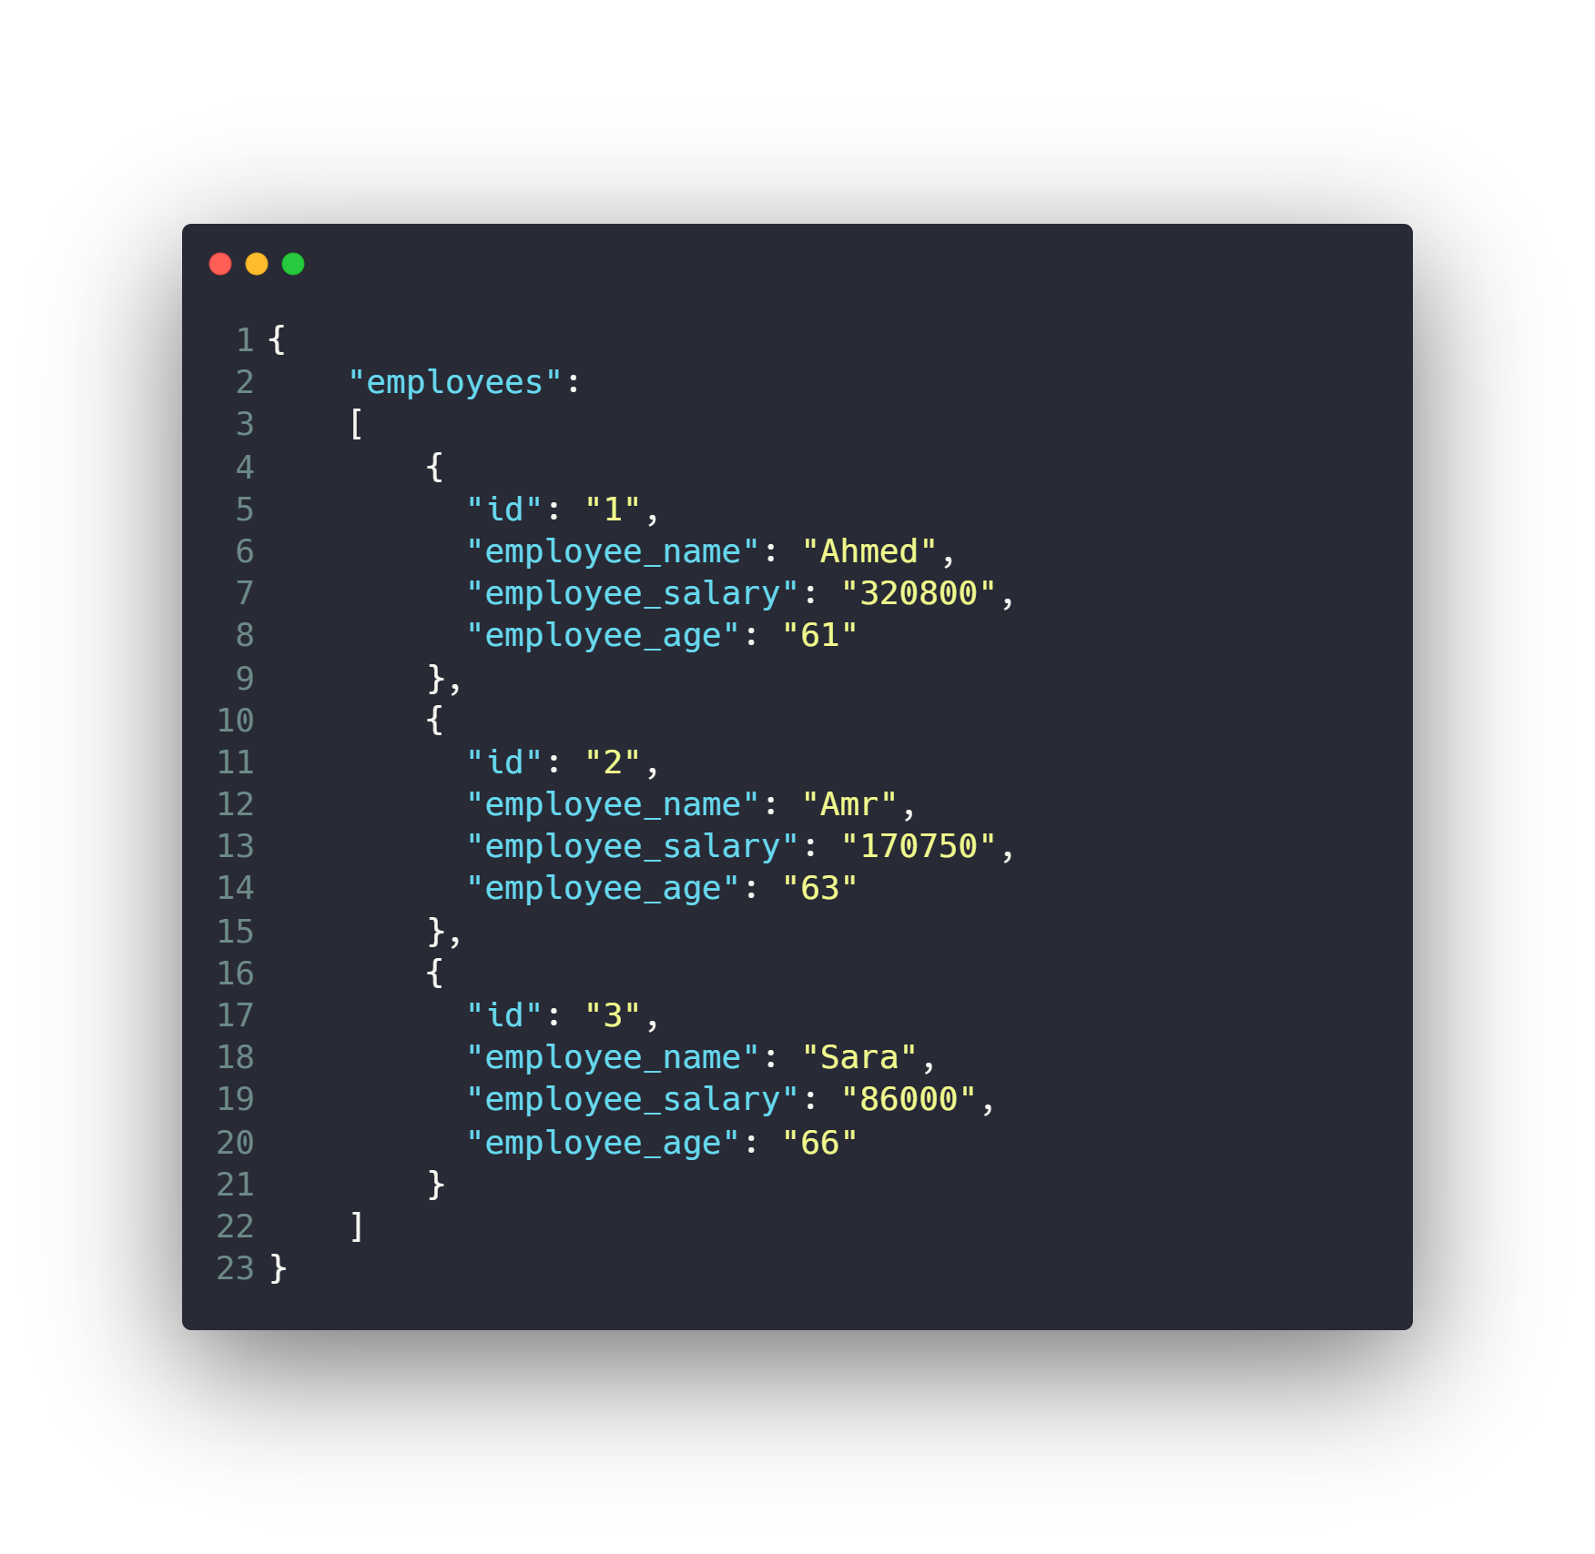
Work with JSON

Slide 37
Work with JSON
Install JSON Viewer extension
For chrome or firefox
https://chrome.google.com/webstore/detail/json-viewer/gbmdgpbipfallnflgajpaliibnhdgobh

Slide 38
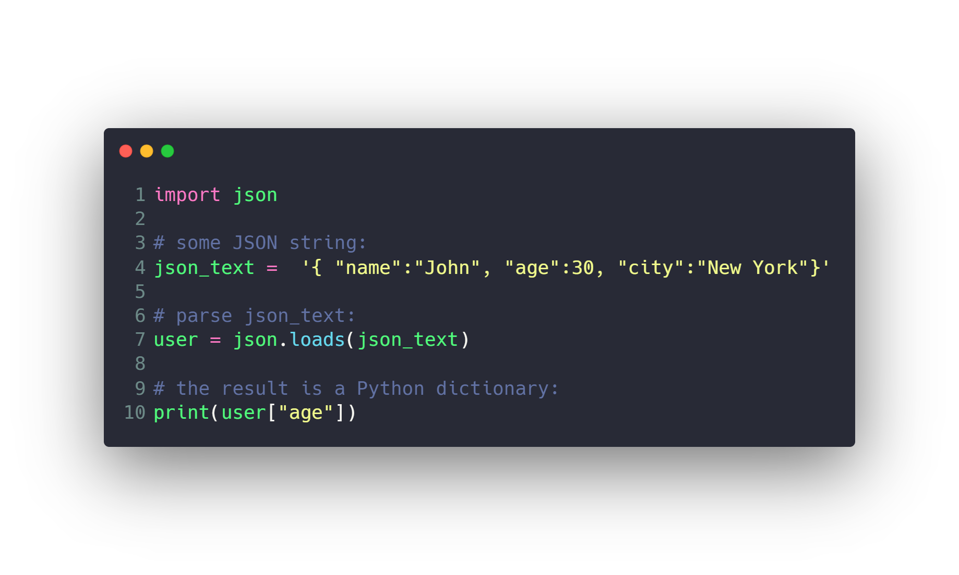
Work with JSON

Slide 39
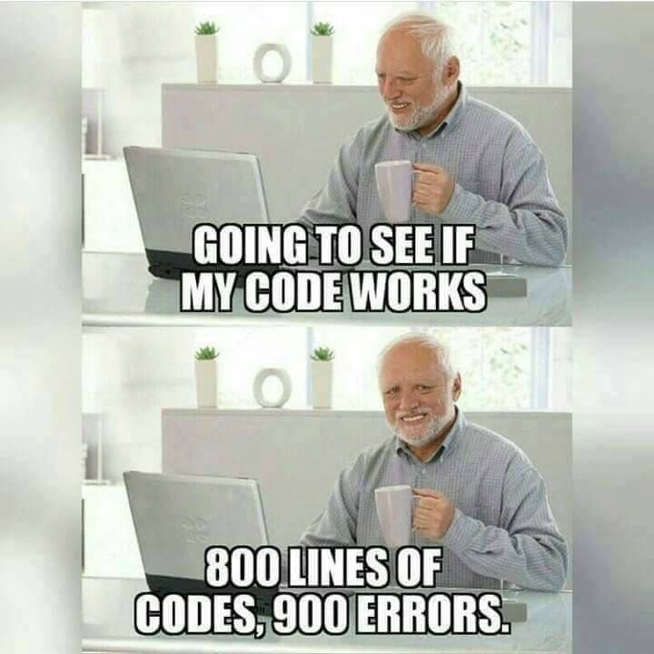

Slide 40
Questions ?!

Slide 41

Thanks! >_ Live long and prosper

